Slide 1

Testing Session-1

Slide 3
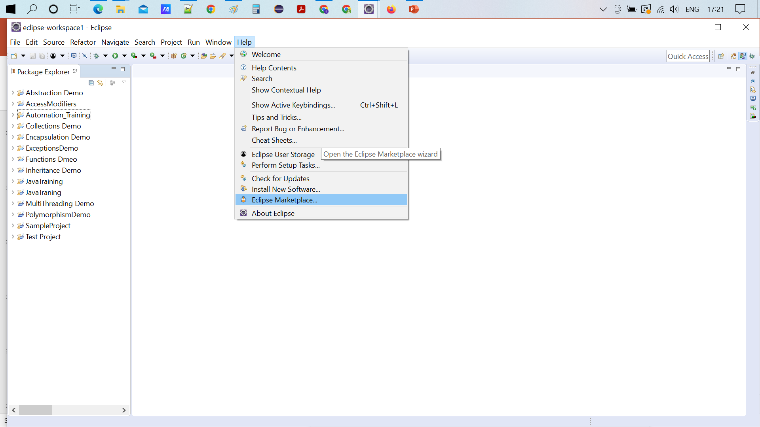

Slide 4
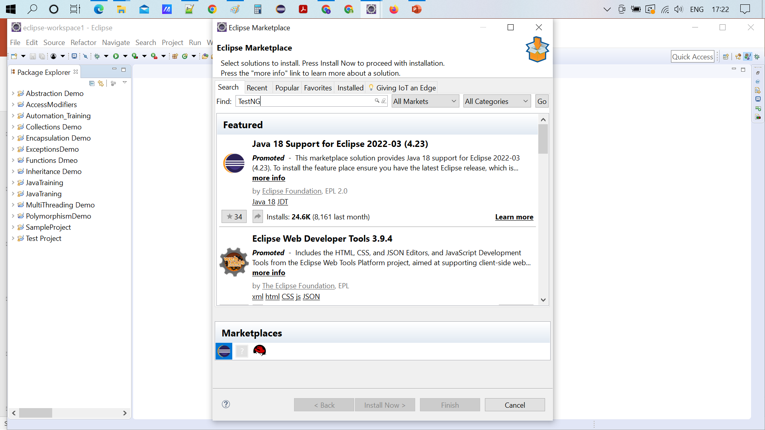
Type TestNG and click on enter button

Slide 5
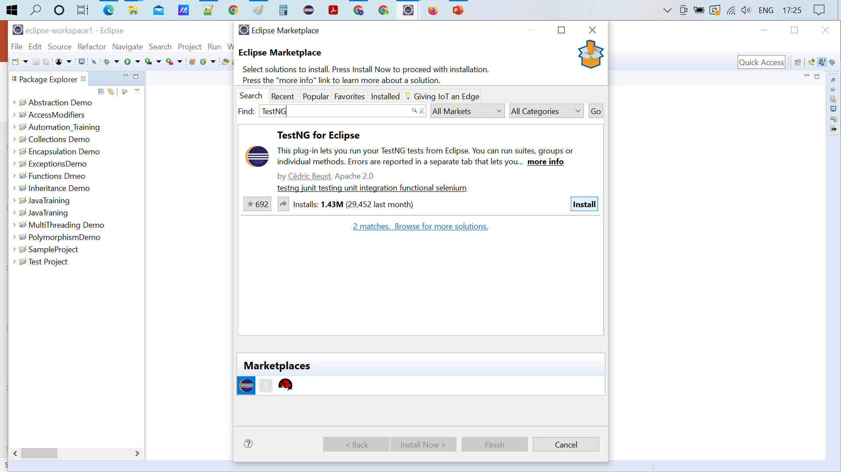
Click on Install button

Slide 6
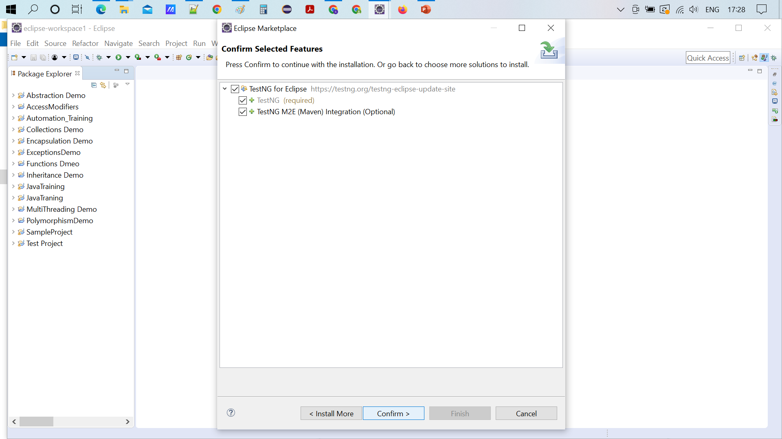
Make sure 3 options checked and click on confirm button

Slide 7
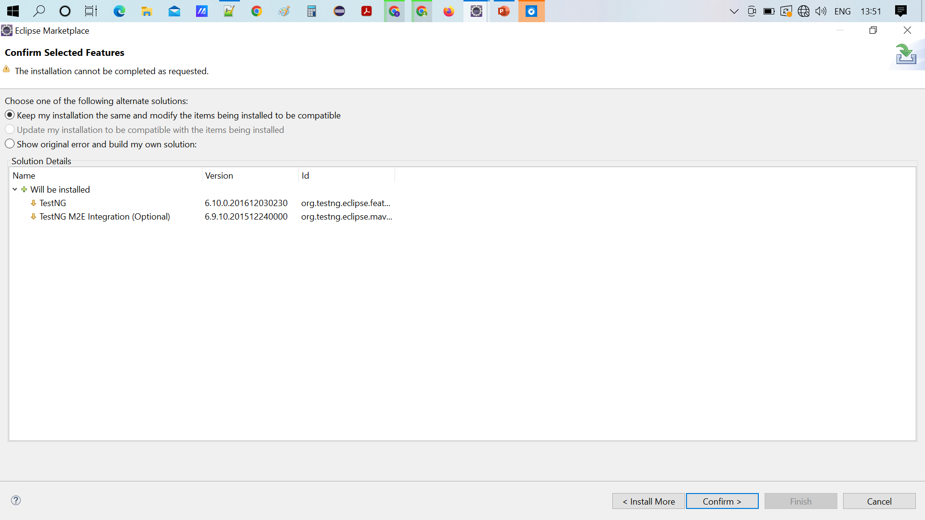
Click on confirm

Slide 8
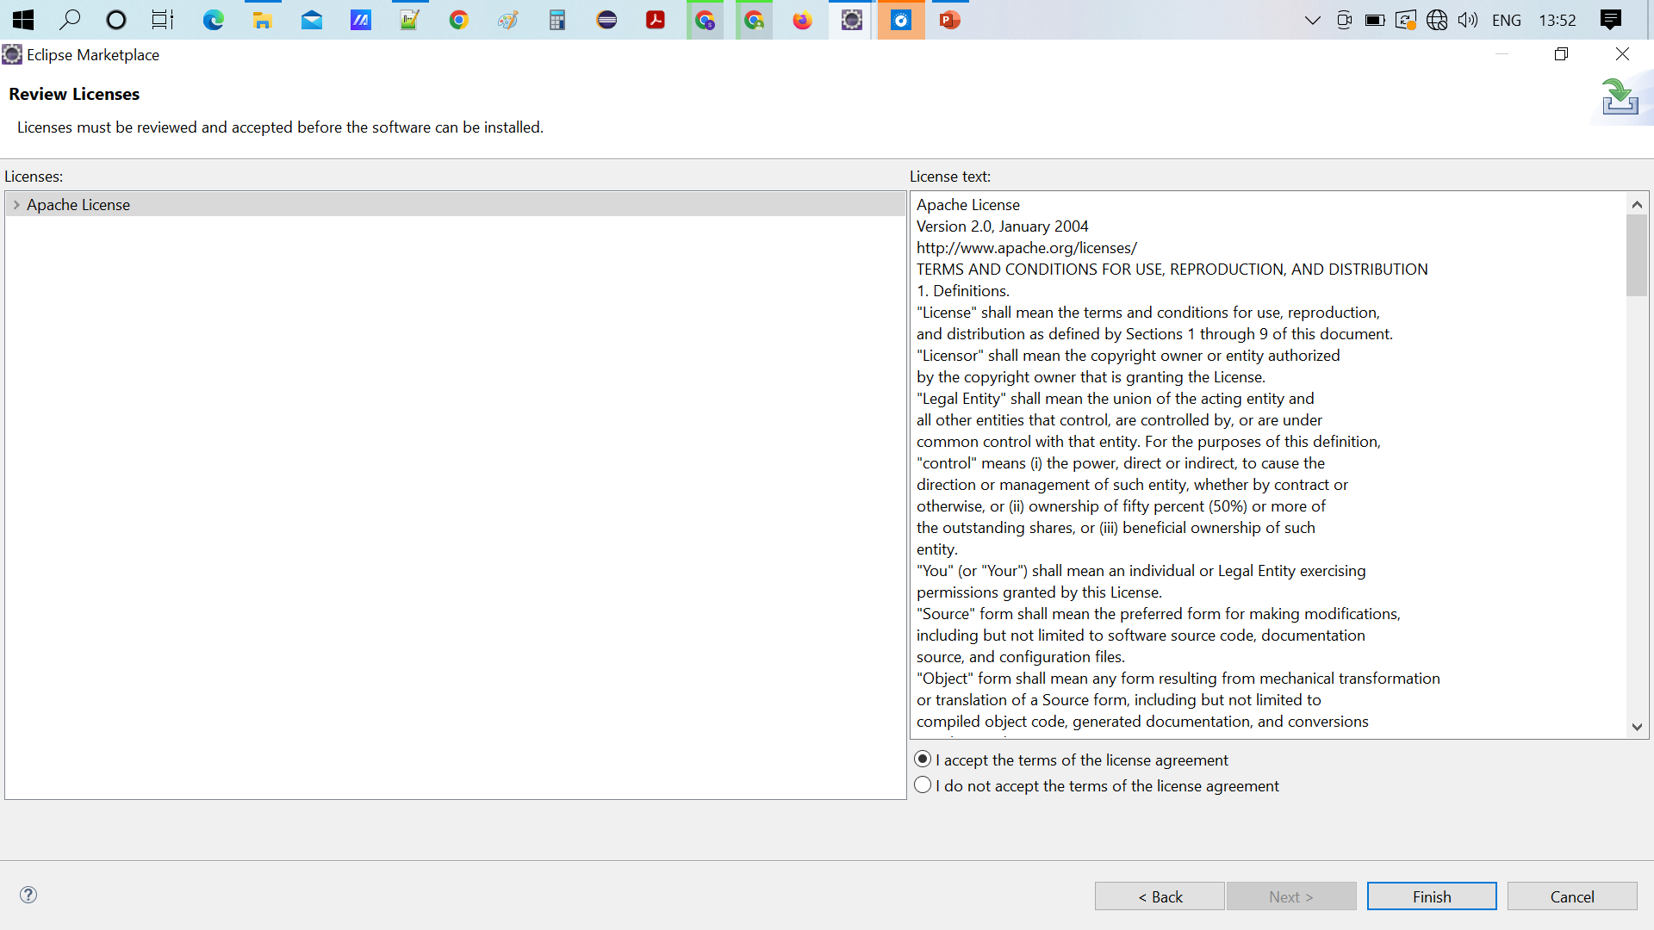
Click on I accept Agreement and click Finish

Slide 9
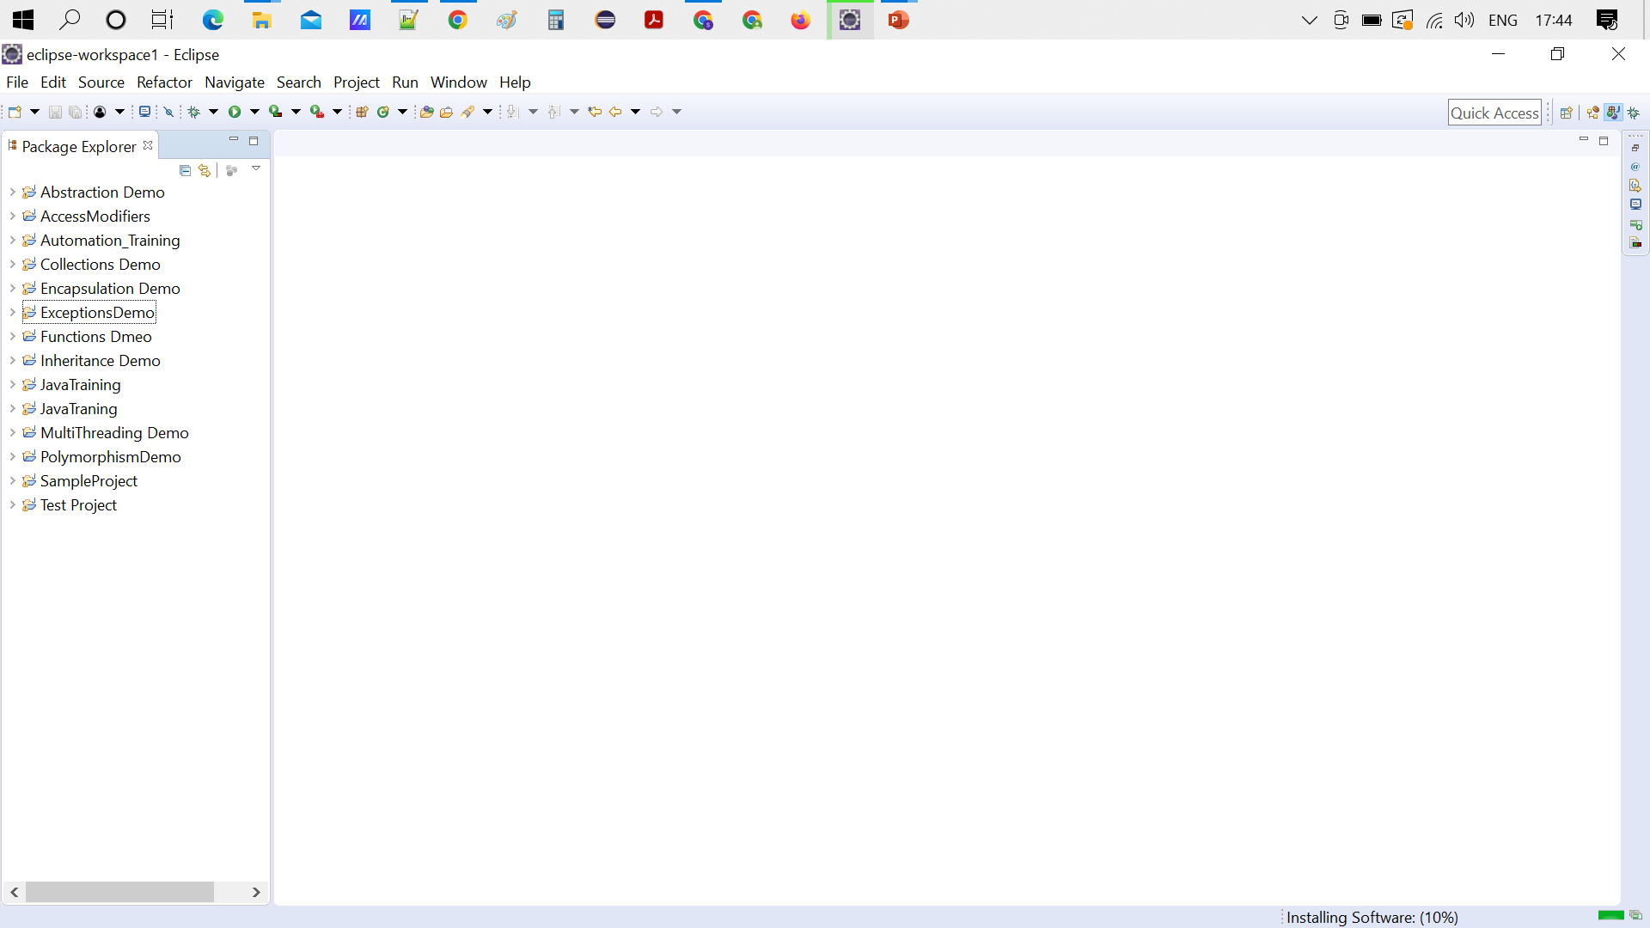

Slide 10
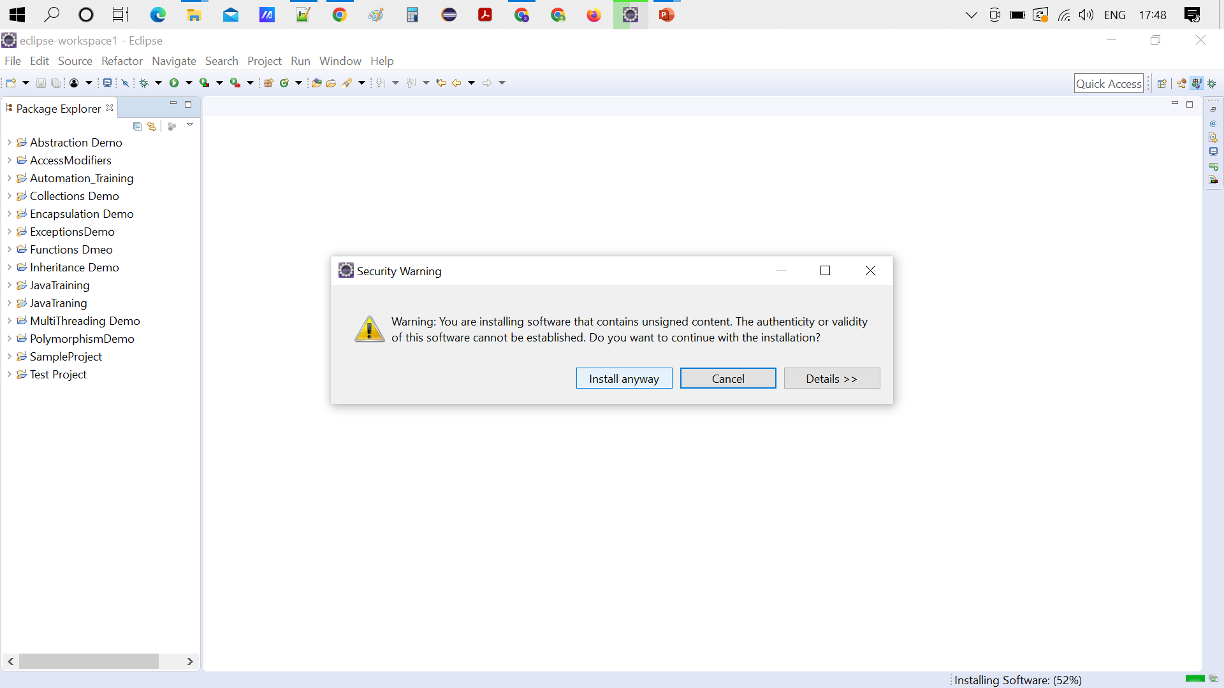
Click on Install anyway
After installation click on Restart

Slide 11
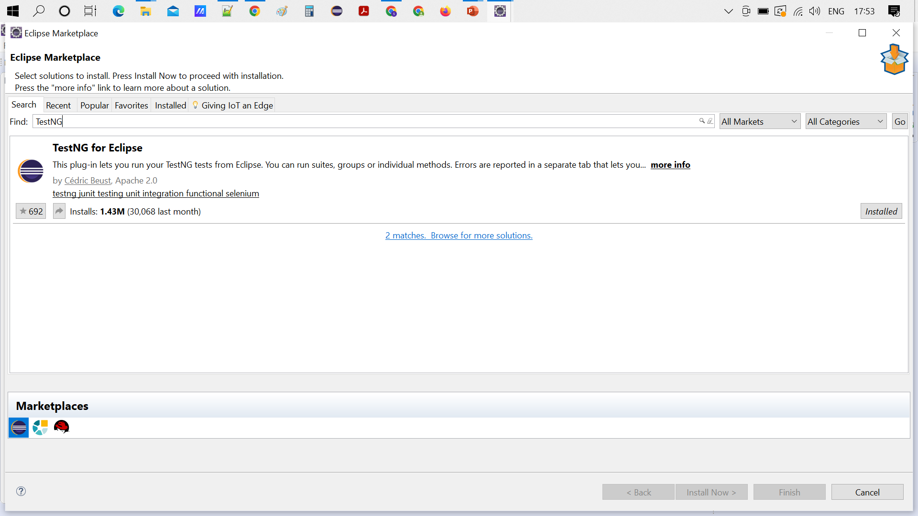
To verify the TestNG installed or not ,again go to help and eclipse market place and Type TestNg

Slide 12
Why Swhizz?
Follow the project-oriented training
One to One monitoring
Work on user stories
Expertise in resume preparation
Mock interviews
Job assistance
Real time people will deliver the classes
Hand on experience.
50+ Client connections for placement

Slide 13
Any Queries?

Slide 14
Thank You
Mr.SubbaRao (Relationship Manager)
Contact:9059002244

